Slide 1

Architectural Patterns & Styles
Software Architecture
3rd Year – Semester 1
Lecture 9

Slide 2
What are Architectural Styles?
An architectural style, sometimes called an architectural pattern, is a set of principles that shapes an application, a system or a system of systems.
An architectural style improves partitioning and promotes design reuse by providing solutions to frequently recurring problems.
Provides a common language to understand systems – often not coupled with specific technologies/frameworks (Java, .NET, etc.) thus facilitates higher-level conversations.

Slide 3
Common Architectural Styles
Monolithic
Client-Server
Component-based
Layered
N-Tier
Object Oriented
Blackboard
Event Driven
Domain Driven
Plugin
Microservice
Peer-to-Peer
Rule-based
Service Oriented
Message Bus
Pipe and Filter
REST
Publish-Subscribe
Cloud

Slide 4

Client-Server Architecture
Server can server multiple clients at a time
Server usually provides a function, data, content, etc... to the client
Centralized
Client knows how to locate the server
Connection could be HTTP, RPC, etc.…

Slide 5
Client-Server Architecture in practice
Examples:
Outlook Email - Outlook [Thick Client] connects to Microsoft Exchange Server via SMTP/POP
Gmail - Web Browser [Thin Client] connects to Google Mail Server via HTTP
Advantages:
High Security (centralized)
Disadvantages:
Single point of failure (server centric)
Maintenance & Downtime issues

Slide 6
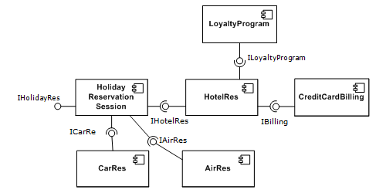
Component-based Architecture
Emphasize on Separation of Concerns
Components are reusable
Components are highly cohesive and loosely coupled
Components are made to be substituted

Slide 7
Component-based Architecture in practice
Examples:
Java libraries (.jar files)
Windows OS .dll files
Advantages:
Reusability (reduce development cost)
Extendibility – each component can be further adjusted
Disadvantages:
Managing a large component base may be harder

Slide 8
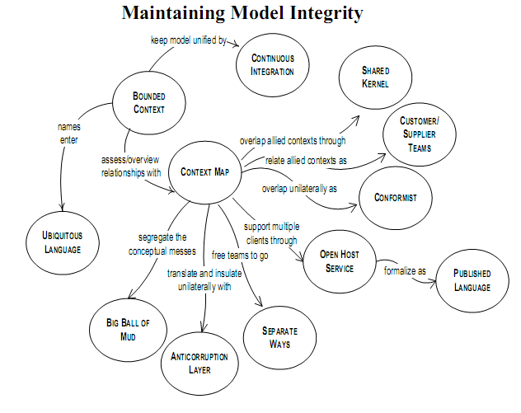
Domain Driven Architecture
Focus mainly on Domain & Logic around it
Technical and Domain experts collaborates
Ontology – Knowledge Representation

Slide 9
Domain Driven Architecture in practice
Examples:
Web Content Management Systems
Advantages:
Easy for the Domain experts
Disadvantages:
When there is a larger team the system gets very complex and disorganized
Notes:
Larger teams are usually moderated: content adding/editing is moderated to keep the content and their relationships organized
Can combine with a user/group permission model to operate successfully

Slide 10
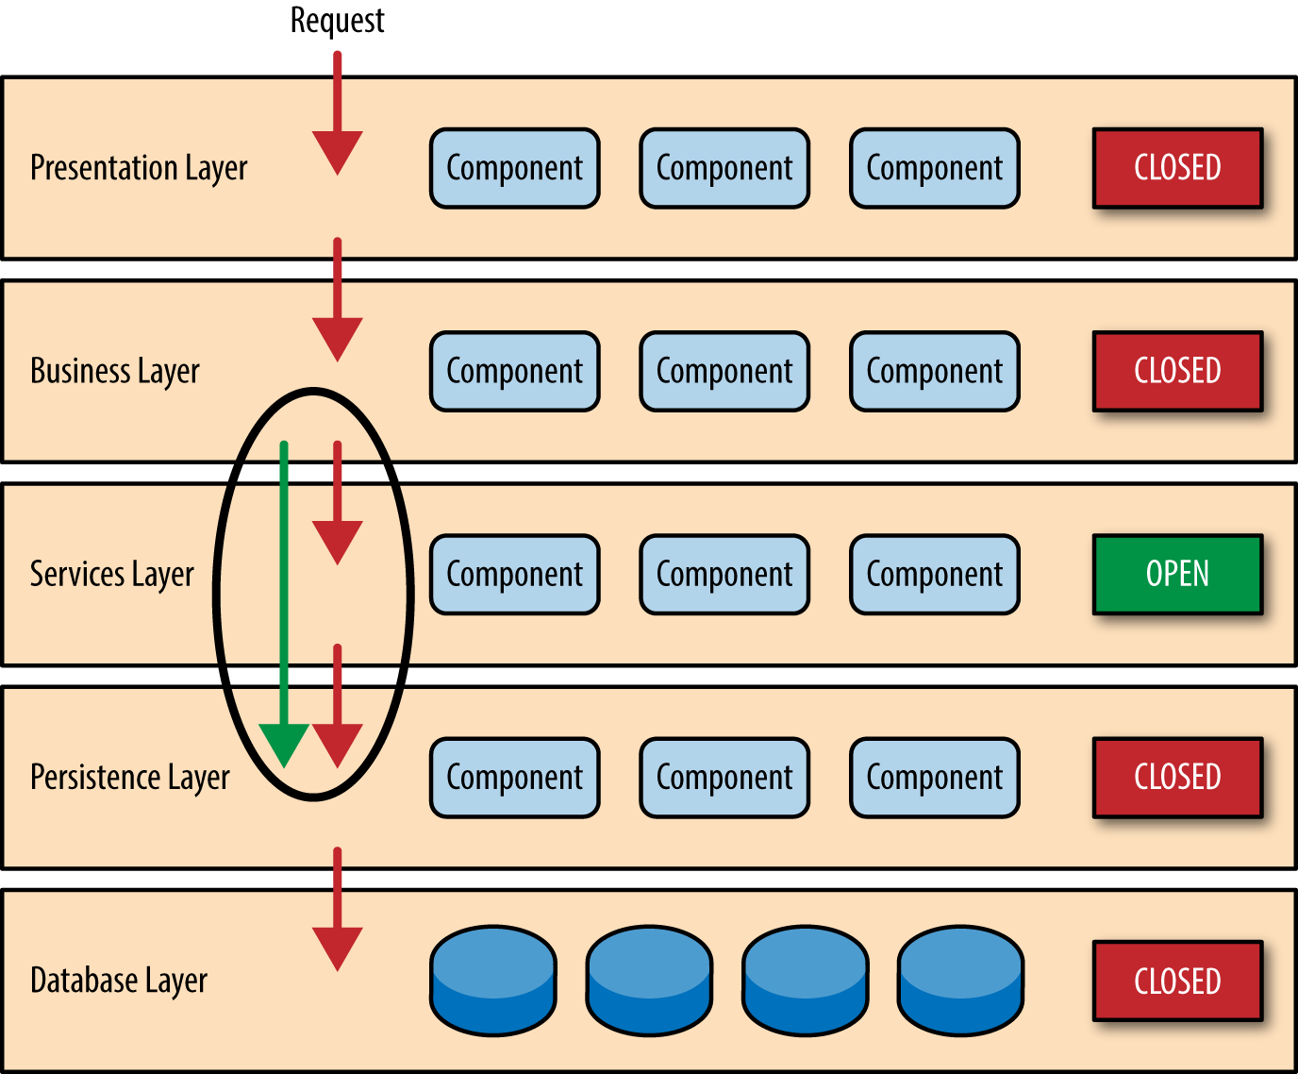
Layered Architecture
Groups related functions in to layers
Layers are stacked on top of each other
Typically components in one Layer can communicate with components in same layer or Layers below
Layering helps Separation of Concerns

Slide 11
Layered Architecture in practice
Examples:
Applications with Presentation, Service and Data Layers
TCP/IP
Advantages:
Shares many advantages similar to Component Based Architecture
Layered Architecture can extend to N-Tier Model
Disadvantages:
Components in bottom layers cannot communicate with top layers without Cyclic dependencies

Slide 12
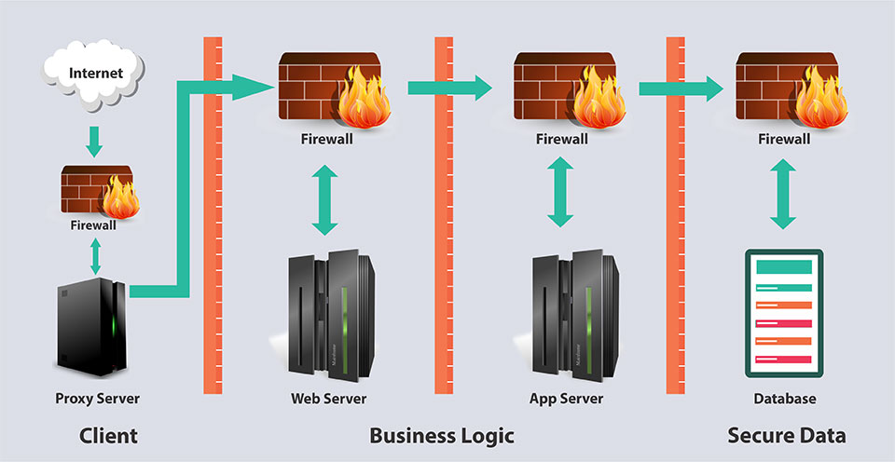
N-Tier Architecture
Can be considered as an extension to Layered Architecture with each layer having the ability of executing on different physical locations

Slide 13
N-Tier Architecture in practice
Examples:
Commercial Web Applications
Advantages:
Shares many advantages similar to Layered Architecture
Can be scaled up to support increasing demand
Multiple nodes can be allocated to a tier that requires more resources
Disadvantages:
Maintenance of multiple nodes
Data communication cost

Slide 14
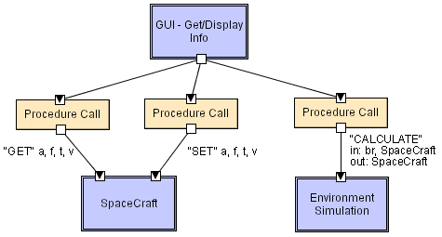
Object Oriented Architecture
Views the system as a set of cooperating objects
Components are Objects:
Objects contain data and behaviors
Objects are reusable and cohesive
Connectors are messages:
Method invocations (via interfaces)
Based on Key Principles:
Abstraction
Encapsulation
Inheritance
Polymorphism

Slide 15
Object Oriented Architecture in practice
Examples:
Most of modern applications
Advantages:
Reusability
Extensibility
Highly Cohesive
Support of many Design/Development tools (e.g. UML)
Disadvantages:
Speed
Effort (short term Cost implications)

Slide 16
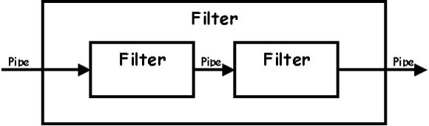
Pipe and Filter Architecture
Components are filters
Transform input data streams into output data streams
Possibly incremental production of output
Filters are independent (no shared state)
Filter has no knowledge of up- or down-stream filters
Connectors are pipes
Pass data (output) of one filter to another (input)

Slide 17
Pipe and Filter Architecture in practice
Examples:
Unix/Linux Shell (Single Processing)
Compilers: consecutive filters perform lexical analysis, parsing, semantic analysis, and code generation
Advantages:
Can add/remove filters easily
Concurrent Execution: each filter can be implemented as a separate task and be executed in parallel with other filters
Disadvantages:
Performance – may force a lowest common denominator on data transmission
No filter cooperation
Notes:
$ls -l | grep "Aug" | sort

Slide 18
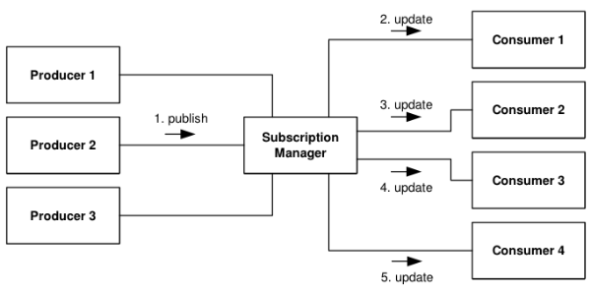
Publish-Subscribe Architecture
Subscribers register/deregister to receive specific messages or specific content
Publishers broadcast messages to subscribers
May use Proxies to manage distribution
Topic based or Content based
Notes:
Topic Based: Subscriber will receive all messages in the Topic
Content Based: Subscriber can define criteria for filtering for receiving messages

Slide 19
Publish-Subscribe Architecture in practice
Examples:
Mobile News Alerts, Mobile App Push Notifications (e.g. GCM)
Advantages:
Can avoid Polling for new messages (save bandwidth / power)
Can use queues / message bus to manage
Highly scalable
Disadvantages:
Focus mainly on one-way communication
Decoupling of Subscriber from Publisher

Slide 20
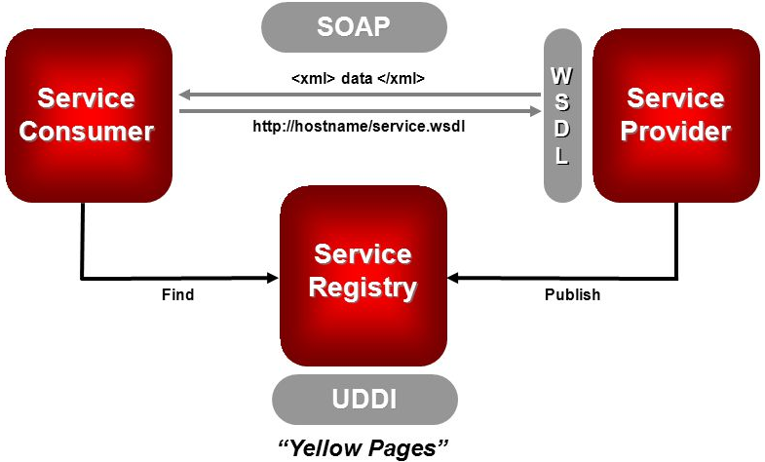
Service Oriented Architecture
Application functionality is provided as a set of remote services
Uses standard communication protocols
Service and Clients are independent of vendors, products and technologies
Based on key principles:
Autonomous
Standard Service Contract
Abstracted & Encapsulated
Distributable & Discoverable
Etc.
Notes:
Autonomous: Loosely Coupled; each service is maintained, developed, deployed independently
Standard Service Contract: Services adhere to a standard communications agreements (i.e. WSDL, SOAP)
Abstracted. Services act as a black box, internals are hidden to the consumer
Encapsulated. Services are self contained to achieve their functionality (Note: One service can connect to another to process)
Distributable. Services can be located anywhere on a network, locally or remotely
Discoverable. Services are provided with metadata to locate and interpret the communication (i.e. UDDI)

Slide 21
Service Oriented Architecture in practice
Examples:
Many SOAP based Web Services
Advantages:
Interoperability – can integrate products built with different technologies
Reusability
Widely used – well defined standards & tools
Disadvantages:
Requires high availability

Slide 22
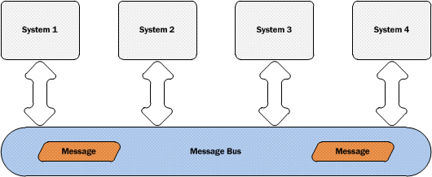
Message Bus Architecture
Systems communicate with each other by passing messages [Asynchronous] via a common intermediator [Bus]
Widely used for Enterprise Application Integration (EAI)
Many SOA systems use message oriented middleware

Slide 23
Message Bus Architecture in practice
Examples:
Enterprise Service Bus (JBoss, Mule, WSO2, …)
Advantages:
Extensibility - Can easily add/remove applications from the bus
Can integrate with different technologies (via standard communication protocols)
Highly Scalable
Disadvantages:
Requires middleware

Slide 24
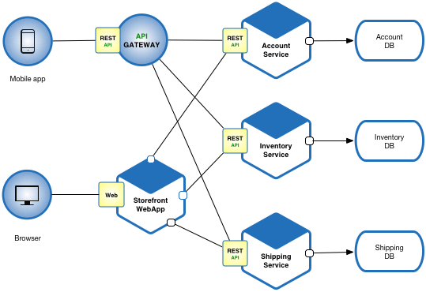
Microservices Architecture
Similar to Service Oriented Architecture (SOA)
Structures the system as a collection of loosely coupled services
Decomposes services in to much smaller but more cohesive computation units
Uses lightweight protocols for communication

Slide 25
Microservices Architecture in practice
Examples:
Netflix, Twitter, Amazon
Advantages:
Having light weight communication protocols allow thin clients to connect
Supports better Continuous Integration & Delivery CI/CD
Easy to deploy and scale services independently
Disadvantages:
Maintenance require special [Dev Ops] skills
Increase Network Communication within the System

Slide 26
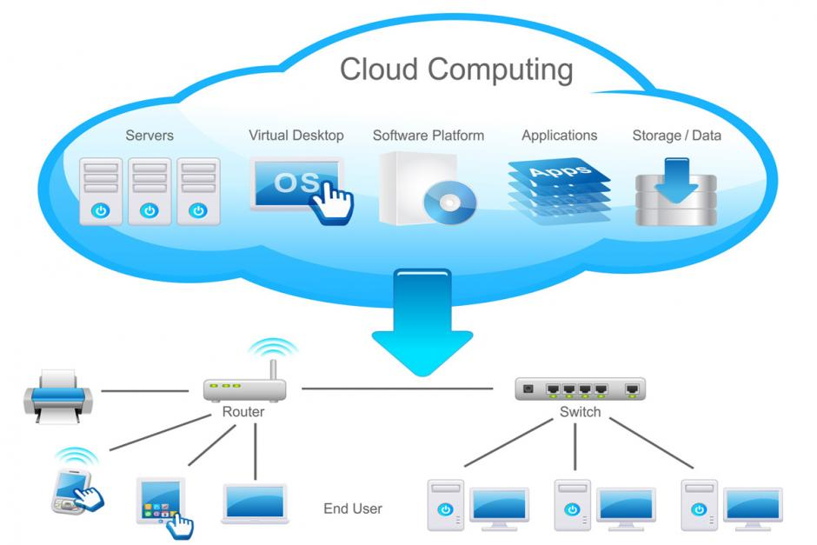
Cloud Architecture
Enables access to shared pool of resources
Can be rapidly provisioned to a new consumer
Let the business focus on its core business instead of infrastructure
Basic models of Could Computing:
IaaS, PaaS, SaaS (can achieve multi tenancy)
Notes:
E.g. Buying a House Vs. Renting Vs. Staying at a Hotel Room

Slide 27
Cloud Architecture in practice
Examples:
Amazon AWS based systems, SalesForce
Advantages:
Elasticity – can scale up and down on-demand
Pay as you grow
Disadvantages:
Security Concerns – All information with third parties
Notes:
iCloud hack to obtain personal information such as Photos

Slide 28
Combining Different Architecture Styles
The overall Architecture of a System is most of often a combination of multiple Architectural Styles
E.g. Layered combined with Object-Oriented with a Component-based deployment
Factors involved:
Knowledge/Experience/Capabilities of the Development Team
Organizational Constraints (i.e. Data Security Vs. Cloud / SaaS)

Slide 29
References
Software Architecture Patterns; by Mark Richard
https://msdn.microsoft.com/en-us/library/ee658117.aspx
Software Architecture: Foundations, Theory, and Practice; by Taylor & Medvidovic

